Slide 1
Deep-learning Your Brain
Classification of movement execution and imagination using EEG signals
Tim Fischer, Özhan Özen, Joaquin Penalver-Andres
21st May 2019, University of Bern, Advanced Topics in Machine Learning

Slide 2
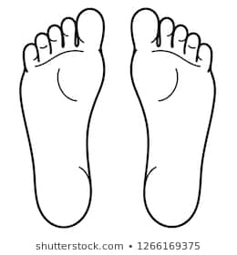
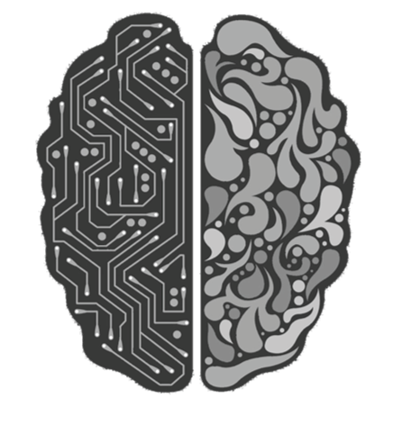
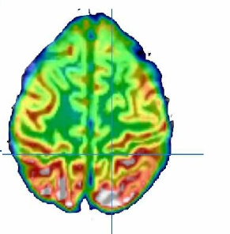
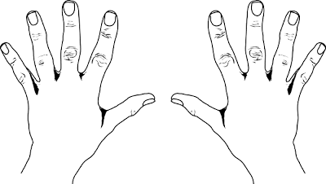
Classification of movement execution and imagination using EEG signals
What do we aim for?
OR
OR

Slide 3
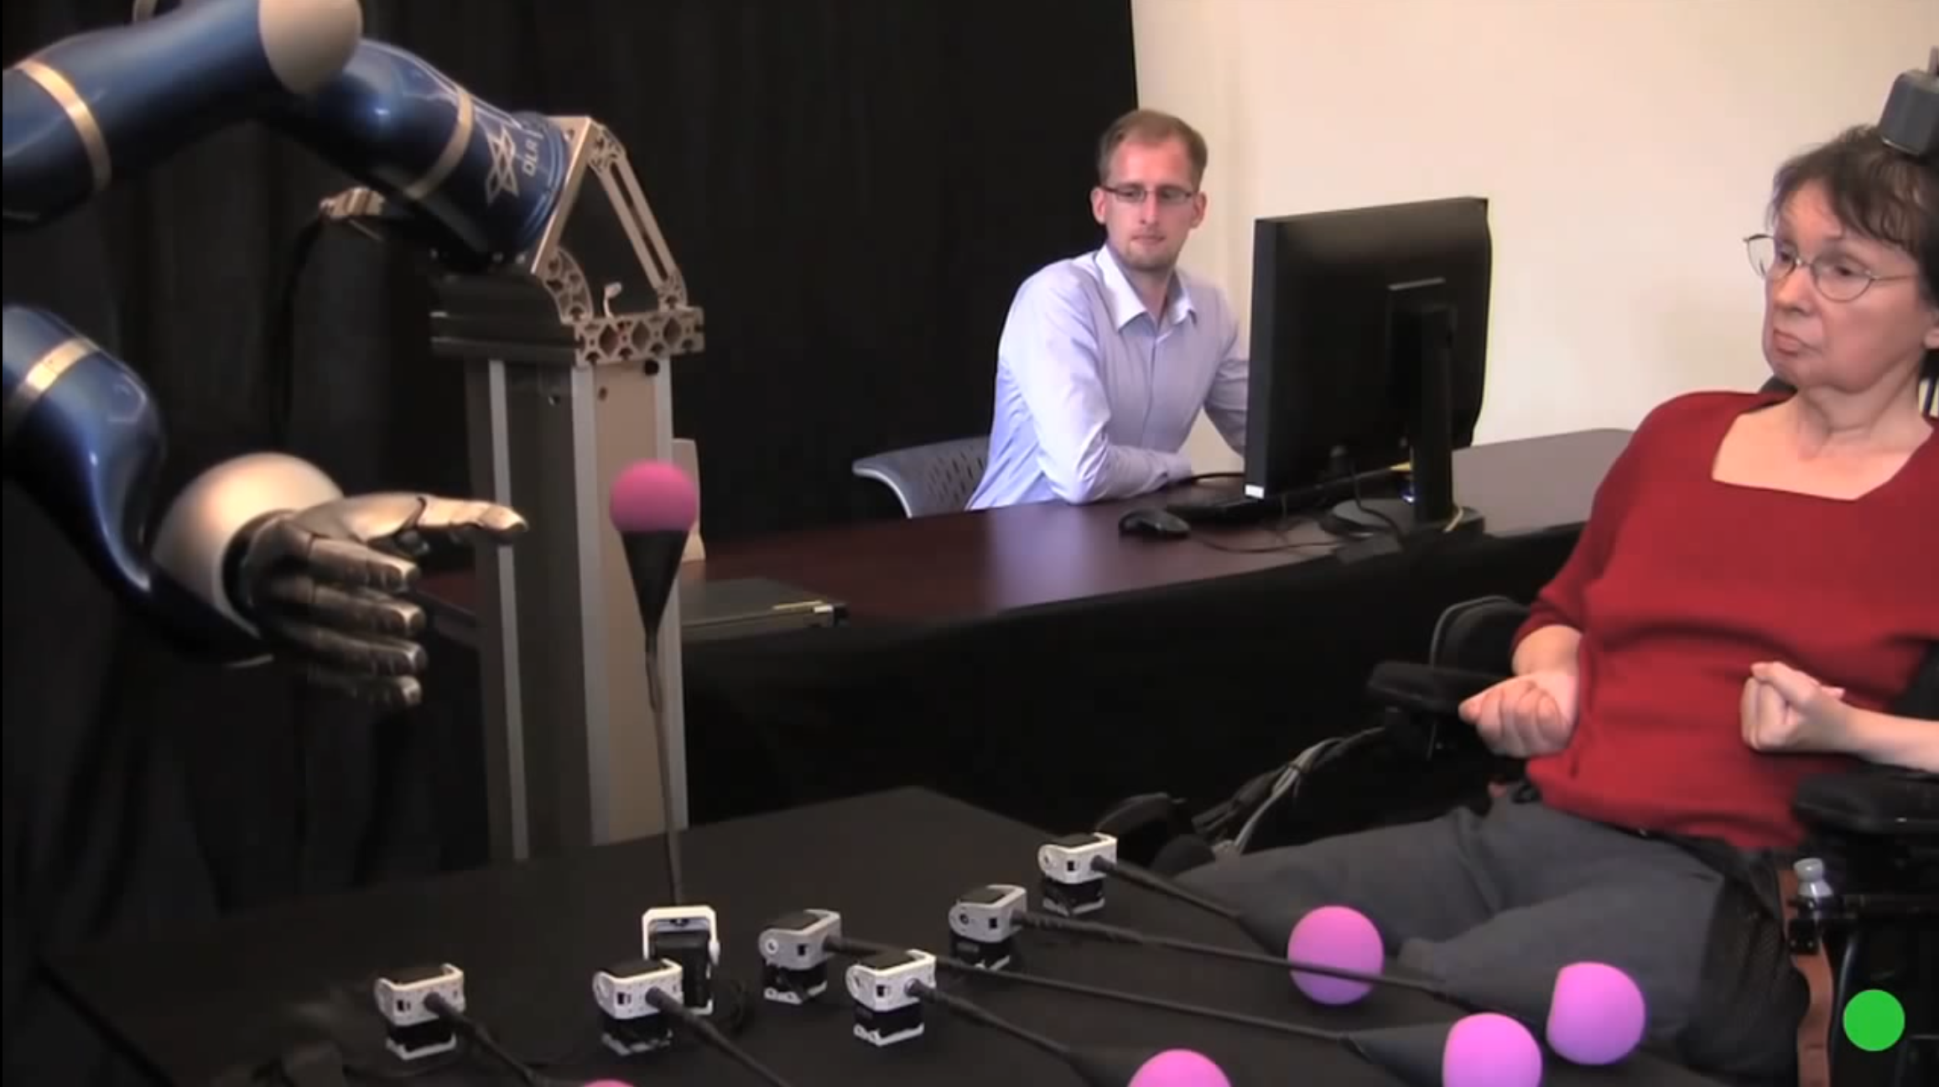
Why to read your mind?
Current and future applications

Slide 4
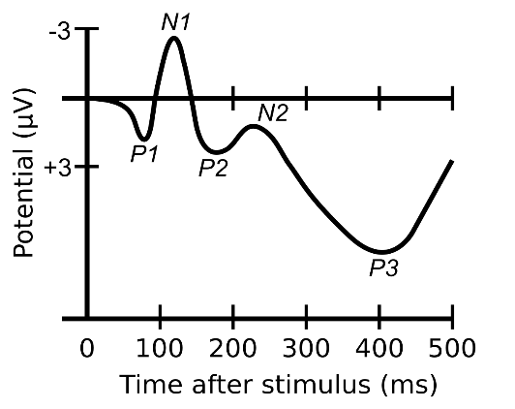
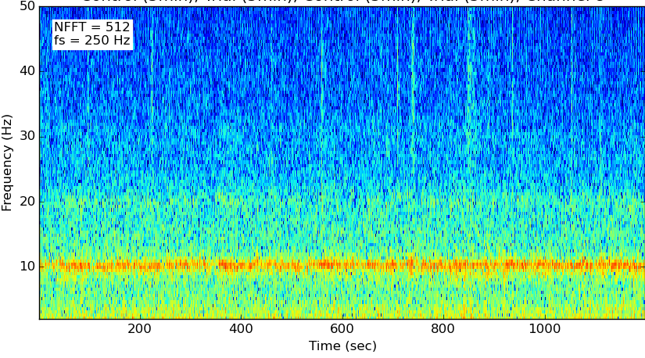
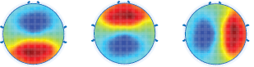
How to understand people’s intention?
EEG Basics
Time Domain
Frequency Domain
Spatial Domain

Slide 5
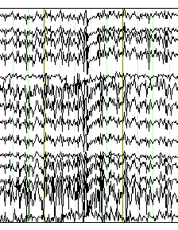
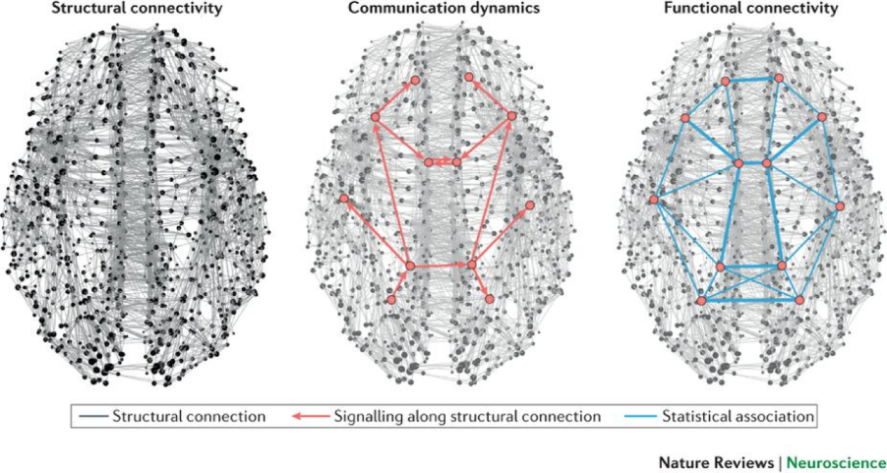
Each person, one world
Challenges in EEG analysis
Images:
Imagenet
>14 mio. Images
EEG:
Physionet BCI 2000
109 subjects, 64 electrodes, 7 different tasks
Artefacts
Complex neural processes
Limited Data

Slide 6
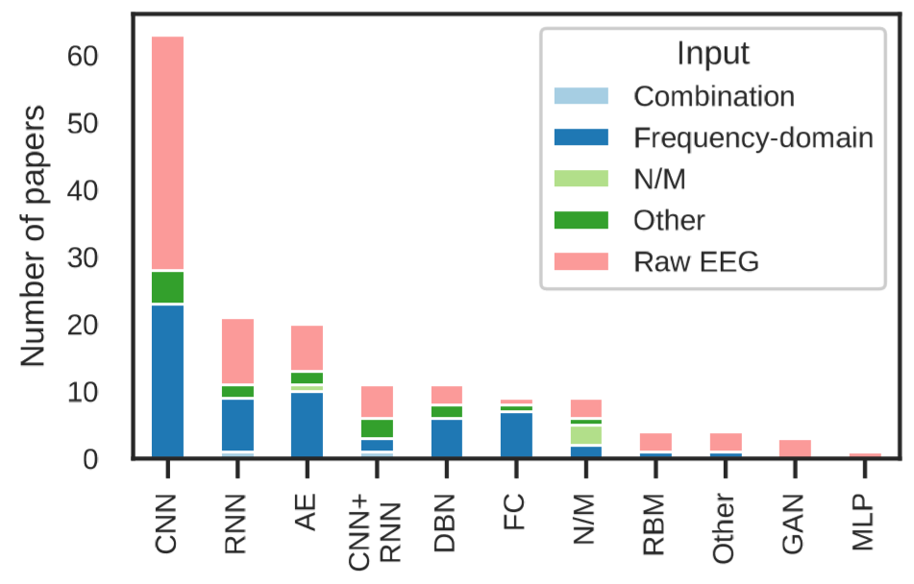
Prior attempts
Deep Learning on EEG Data
Zhang et al. (2018), Advances in Knowledge Discovery and Data Mining
20 subjects, 5 tasks
Sliding window (10 points, 50% overlap)
3D-CNN + LSTM + RL
93% accuracy
Schirrmeister et al. (2017), Hum. Brain Mapp
Compared FBCSP, Deep and Shallow CNN in 5 task clasiffication
Best accuracy over datasets 93% in Shallow CNN
Yannick et. al. (2019), arXiv:1901.05498

Slide 7
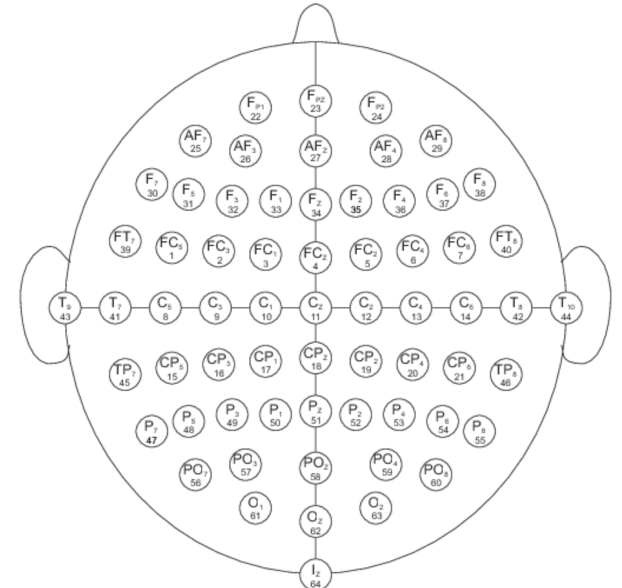
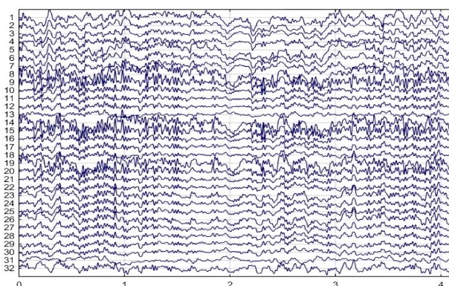

Network structures used
320 (or 10*)
64
11
x32
320 (or 10*)
10
3x3x3
x32
7x3
exRH
exLH
imRH
exLH
exRF
exLF
imRF
imLF
x64
x64
x128
x128
2D CNN
3D CNN (Zhang,2018)
FC Linear
FC Linear
Adam optimizer, Cross Entropy Loss, *with Time Cropping

Slide 8
Results
Class | Test accuracy
Exec. Left Hand | 75%
Exec. Right Hand | 78%
Imag. Left Hand | 75%
Imag. Right Hand | 76%
Exec. Both Hand | 80%
Exec. Both Feet | 76%
Imag. Both Hand | 76%
Imag. Both Feet | 77%
Neural Network | Test Accuracy
3D-CNN cropped
3D-CNN | 28.9%
2D-CNN cropped | 73.1%
2D-CNN | 32.2%
77.1%

Slide 9
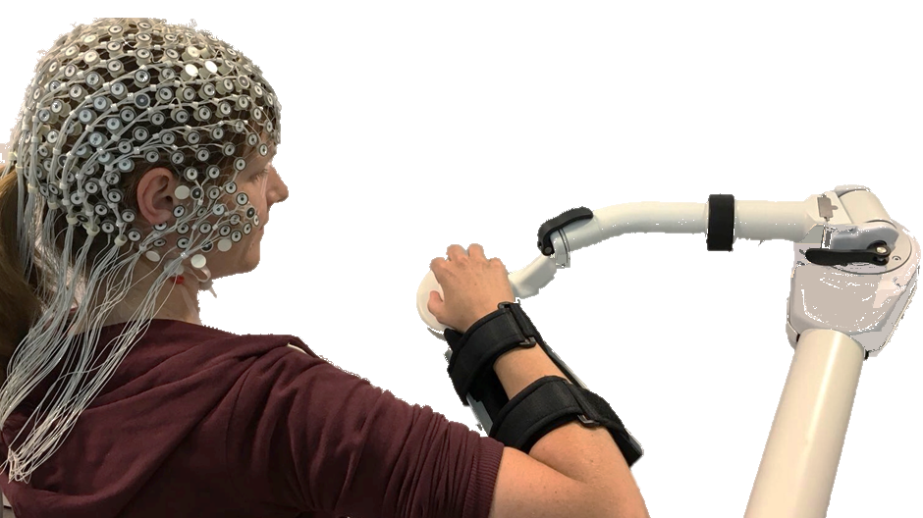
Discussion and Future Works
Time cropping is improving performance. Better local temporal information (high frequency), in exchange of slowly changing global temporal change information.
3D-CNN outperforms 2D-CNN due to exploitation of spatial information.
Future Steps:
Integrate RNN to capture global temporal aspects (Zhang, 2018).
Using transfer learning to exploit big Phisionet dataset for motor learning experiments with robots.

Slide 10
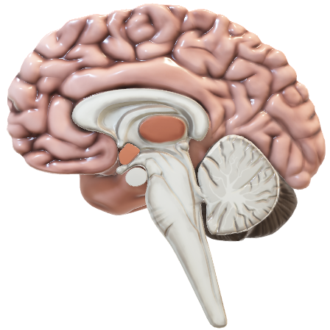
Thanks for your attention!
Questions…?

